Slide 1
Introducing ELAN for Sociolinguistics
L
Naomi.Nagy
@utoronto.ca
Notes:
There’s lots of info you can use at:
http://individual.utoronto.ca/ngn/research/heritage_lgs.htm
> Software
Note: use Command+Enter or Command+Return (not Control) in Mac (contra what the manual says)

Slide 2
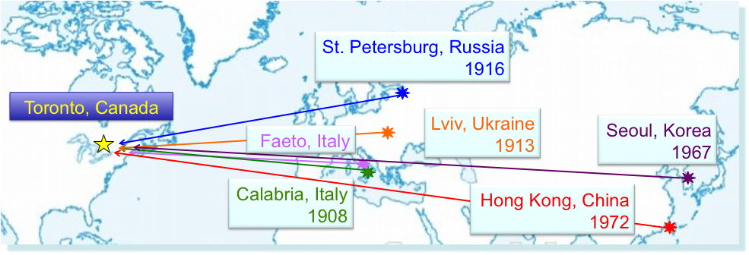
HLVC Languages
6 languages * 3 generations * 3 age groups * …
Unknown set of variables to be compared ( 3 so far)
~20 RAs have prepared files
~14 students have used them

Slide 3
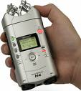
RECORD
TRANSCRIBE
EXTRACT & CODE
ANALYZE
ELAN
ELAN
Concordance (as .txt)
Basic frequency stats
Export to other programs
F1M23A.eaf
F1M23A_var1.eaf
F1M23A.wav
F1M23A_var2.eaf
Export to .txt
F1M23A_var3.eaf
Some other program
Import to ELAN
Transcriber
Some other program
var1.tkn
Chat/CHILDES
Shoebox
Copy & paste
Toolbox
Export / Copy & Paste
FLEx
Text files
F1M23A_var1.xls
Praat Textgrid
F1M23A.doc; F1M23A.txt, etc.
var1.res
Notes:
You can easily cut up or paste together files using Audacity (http://audacity.sourceforge.net/download). Either select the relevant portion and choose “Export selection as .wav” from the File menu or copy and paste relevant sections, one following another, into a new Audacity file. “Export as .wav” is the final step for any new file you create.
2) Miriam Meyerhoff & Sandy Nicholson have created a tool called align.html to help w/ importing (older) text files and getting them time-aligned with their .wav file in a format that can be imorted to ELAN.

Slide 4
Export to other programs
4.2.22. Exporting a document to Shoebox
4.2.23. Exporting a document to Toolbox (UTF-8)
4.2.24. Exporting a document as a tab-delimited text file
4.2.25. Exporting Tiger XML
4.2.26. Exporting CHAT files
4.2.27. Exporting traditional transcript files
4.2.28. Exporting a Praat TextGrid file
4.2.29. Exporting an alphabetical list of words
4.2.30. Exporting a part of a clip
4.2.31. Exporting a SMIL clip
4.2.32. Exporting to QuickTime Text
4.2.33. Exporting to Subtitle Text
4.2.34. Exporting ELAN’s document view
4.2.35. Exporting to interlinear text
4.2.36. Exporting to HTML
4.2.37. Exporting to a Filmstrip Image
4.2.38. Exporting Multiple Files
4.2.39. Opening a wave file in Praat
4.2.40. Exporting a selection to a wave file with Praat
(straight from the ELAN manual)

Slide 5
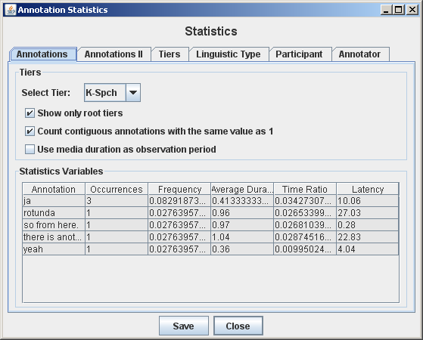
Concordance (as .txt) & Basic frequency stats
about words, durations, pauses, speakers, transcribers…
View >
Annotation Statistics
& click on “Save”

Slide 6
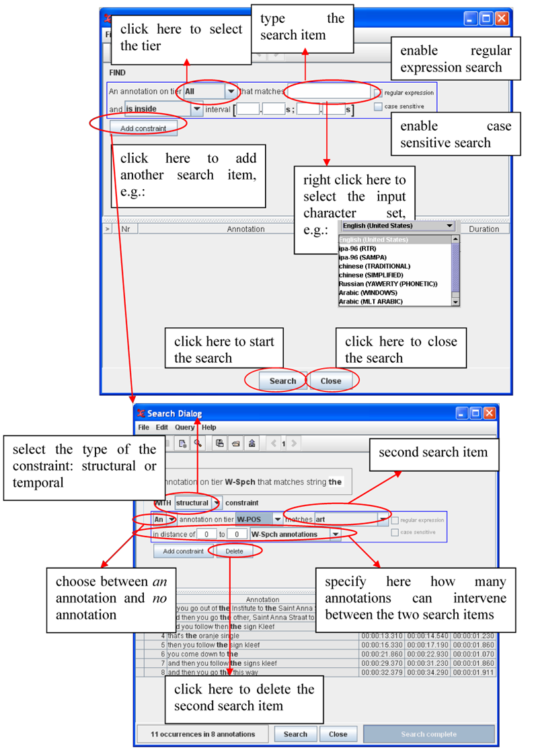
Searching
CTRL + F is very powerful
6.1.1. Advanced searching: an example
Suppose we are investigating turn taking and we want to find all switches from speaker W to speaker K that don’t overlap, with gaps of at most 2 seconds. In order to find this, we fill in the search form as follows:…
(straight from the ELAN manual)

Slide 7
More on Searching
(straight from the ELAN manual)

Slide 8
Getting going in ELAN
Start ELAN.
Choose “New” from the “File” menu.
Choose “AUTO BACKUP > 1 minute” from the File menu.
Edit>Preferences>Edit Preferences > Editing > √ Enter key commits change in the inline box. (This lets you save an annotation just by hitting Enter/Return before you leave the annotation box.)
Immediately save your file.
In the Edit menu, choose “Linked files.”
Select the .wav file for this speaker. You should now see a soundwave in the center of the .eaf window.
If you don’t, Command-Click (+Mouse click) on the place where the soundwave should be (it will be showing as a flat horizontal line) and then choose a number to magnify/Vertical Zoom in by.
If it is still too quiet to hear quickly, use the “Amplify” function to edit the .wav in Audacity.
Test volume. ( menu > System Preferences > Sound > Output or the  icon on the upper right of your monitor.)
Notes:
from HLVC_Transcribing_Guidelines.doc
Note: You can easily cut up or paste together files using Audacity (http://audacity.sourceforge.net/download). Either select the relevant portion and choose “Export selection as .wav” from the File menu or copy and paste relevant sections, one following another, into a new Audacity file. “Export as .wav” is the final step for any new file you create.

Slide 9
Transcribing
Tier > Add New Tier
Create separate tiers in ELAN for each person who speaks in the .wav. You can add more tiers at any point. Name the tiers, for example:
Interviewer NN
Main Speaker F1F58A (a speaker code)
Speaker’s husband who shows up in the middle F1M60A
Highlight a portion of the .wav. Click in the appropriate tier to create an Annotation field in which to transcribe that segment.
Or first break up the recording into Annotation segments, such as sentences.
Use “Segmentation…” from the Tier menu to do this “on the fly.”
Segment lengths can be modified later, so don't worry about it a lot.
Transcribe the segment in that field and click Return.
Notes:
see ELAN_annotation_tips.doc for more on segmenting and creating tiers.

Slide 10
Navigating around in ELAN
You have “bookmarks” to help see where you are in the transcription and for doing text searches.
Clicking on an annotation in “Grid” or “Text” will take you to that part of the wave.
You may find the Shortcut Keys (section 7.2. of the ELAN manual) helpful.

Slide 11
Time-aligned Transcription
Initial transcription is broad.
Add more tiers for details.

Slide 12
What ELAN can look like
Top window with “Controls” selected (instead of “Grid)

Slide 13
Top window with “Text” selected

Slide 14
Coding & Extracting
Linguistic and stylistic factors can be coded directly in ELAN, each on their own tier.
Exportable data file for analysis
Advantages:
See all the context you need, and hear it, as you code each factor.
From ELAN, create a .txt file for multivariate analysis using R or Goldvarb.
Can (repeatedly) revise codes in ELAN and quickly recreate the data file.

Slide 15
One tier for each variable

Slide 16
Making daughter tiers
Choose “Add new linguistic type” from the Type menu.
I named my types
Transcription (IPA-SAMPA font) EX: s´t ike s\ vat\
Translation (English font) EX: this here REFL see
Code (English font) EX: strong + refl or S
For Stereotype, choose “Symbolic Association” (same size segments) OR “Included in” (smaller segments)
Click “Add” for each, then “Close.”
Choose “Add New Tier” from the Tier menu.
Type a new name for the new tier (e.g., “(prodrop) – F1F75A”)
For Parent Tier, select “F1F75A” (the transcription tier)
For “Linguistic Type” choose “Code.”
Repeat for each daughter tier you need to create.
Click Close.

Slide 17
Templates to save time
If you set up lots of tiers, you might want to save the template to use with your future speakers.
This will be called a .etf file
You can select it to open at the same time as you select the audio .wav (or video) file to link to a particular .eaf file – at the “New” step, or Edit > Linked Files.

Slide 18
Export the data for Goldvarb/Rbrul analysis

Slide 19
Export settings
File menu
> Export As…

Slide 20
(Almost) Ready for ’varbing
Open the file in Word or Excel or Goldvarb or R…
File > Export as… > Tab delimited Text. Make sure the filename ends in “.txt”
Select all the tiers that have labels or transcriptions in them.
Select: √ Separate column for each tier
Save as a .txt file, making sure that “UTF-8” encoding is selected.
If you have “funny characters,” follow these steps.
Open the file in a browser (Mozilla Firefox or Safari).
In Safari, choose View > Text Encoding > Unicode (UTF-8)
In Firefox, choose View > Character Encoding > Unicode (UTF-8)
(For Korean, you can choose Character Encoding > Automatic. I’m not sure how this works with other languages.)
You should now see the file with the annotations appearing correctly (as they looked in ELAN).
Select All, then Copy. Open a new Word or Excel document and Paste.
Notes:
See: Exporting_from_ELAN.doc
SAMPA fonts for Mac : http://www.phon.ucl.ac.uk/home/wells/fonts.htm

Slide 21
(Unsorted) coding file
Begin Time - hh:mm:ss.ms | F1F75A | F1F75A -translation | (prodrop) | grm. person | clause type
…
10:59.5 | si kwatra si fata la m bitʃiklɛt | this boy goes+refl. by bicycle. | reflex. | 3 | main
11:01.9 | e la dinɡe dinɡje la koriirə | and there behind, behind the bus
11:05.8 | i vɛn apre a la koriər | he comes after the bus | weak | 3 | m
11:08.7 | e ʃet ike | and this here
11:09.8 | sum | are
11:11.4 | sum biaran sum bai forsɛ e la fa da | the grandfather, the father, maybe, is the (?)
11:14.2 | e la la peɡorə k i ʎɛstə anda dəri | and the the sheep that it went behind | w | 3 | relative clause (r)
dependent
variable
independent
variable #2
independent
variable #1

Slide 22
(Sorted) Coding File
Begin Time - hh:mm:ss.ms | F1F75A | F1F75A -translation | (prodrop) | grm. person | clause type
13:18.4 | anjat la atː | there is the cat | 0 | expl | m
13:30.5 | o sɛt i ʎɛstə kə sə fɛtʃə dəʃkund pə dəso la la lu tawula | expl. this it is that refl. makes hide under the the table | both | 3 | m
11:38.8 | kə s andə fɛrmá kə nə tːravərsaː la vi | that has stopped+refl. so-that they can cross the street | refl | 4 | rel. clause
10:59.5 | si kwatra si fata la m bitʃiklɛt | this boy goes+refl. by bicycle. | reflex. | 3 | main
11:36.6 | sɛt e lu stopːə | This is the stop-sign | strong | 3 | m
13:37.4 | sɛt ike sə vatə sə rir dəso lu dʒariːɛ | this here refl. (?) under the (?) | strong + refl | 3 | m
11:14.2 | e la la peɡorə k i ʎɛstə anda dəri | and the the sheep that it went behind | w | 3 | r
12:35.7 | i tɪndə lo dʒəlaːtə pə tuːt i tɪndə | he holds the icecream for everyone | w | 3 | m
12:37.8 | i tɪndə | he holds | w | 3 | m
Sort rows by dep. variable cell to get rid of "empties"
If using Goldvarb, search & replace
to create 1-character codes

Slide 23
Goldvarbify it in Excel
formula to create token strings
(pro-drop) | grm. person | clause type | ="("&D4&E4&F4&" "&B4&" "&$B$3
0 | e | m | (0em anjat la atː F1F75A
b | 3 | m | (b3m o sɛt i ʎɛstə kə sə fɛtʃə dəʃkund … F1F75A
r | 4 | r | (r4r kə s andə fɛrmá kə nə tːravərsaː la vi F1F75A
r | 3 | m | (r3m si kwatra si fata la m bitʃiklɛt F1F75A
s | 3 | m | (s3m sɛt e lu stopːə F1F75A
dependent
variable
independent
variable #2
useful extra information in your .tkn file
independent
variable #1
copy 1 column to a Goldvarb .tkn file

Slide 24
Create spiffy WWW examples

Slide 25
CuPED turns an .eaf into .html
Scrolls and highlights
each line of text as it plays

Slide 26
ELAN Overview http://www.lat-mpi.eu/tools/elan/elan-description
You can add an unlimited number of annotations to audio and/or video streams.
An annotation can be a sentence, word or gloss, a comment, translation or a description of any feature observed in the media.
Annotations can be created on multiple layers, called tiers.
Tiers can be hierarchically interconnected.
An annotation can either be time-aligned to the media or it can refer to other existing annotations.
The textual content of annotations is always in Unicode and the transcription is stored in an XML format.
ELAN provides several different views on the annotations, each view is connected and synchronized to the media playhead.
ELAN delegates media playback to an existing media framework, like Windows Media Player, QuickTime or JMF (Java Media Framework). As a result a wide variety of audio and video formats is supported and high performance media playback can be achieved.
ELAN is written in the Java programming language and the sources are available for non-commercial use. It runs on Windows, Mac OS X and Linux.

